Slide 1
Yii2 4 Days Course
Web Application Development with Yii2

Slide 2
TRAINER
Experience: 6 YEARS EXPERIENCES - Founder, SQAI Technologies - Technical Manager, GATES IT Solution - System Analyst Programmer, GATES IT Solution - Web Designer, Iwana Solution
Mohd Syafiq Azizi, 27

Slide 3
About this course
This course teaches you how to develop a high performing web application in a 5 days. This course is suitable for anyone with basic HTML and PHP knowledge. Though there are a lot of PHP frameworks in the market, Yii comes with the latest features and lessons learnt to build a modern web application in minutes. The scaffolding feature in Yii helps in generating the code, and hence the developer doesn't have to write code from scratch

Slide 4
What will you learn
Learn the web development and software engineering principles
Develop high performing web applications
Learn the basic features of Yii
Improve PHP knowledge

Slide 5
DAY 1 - PHP REVISION
Introduction

Slide 6

What is PHP?
PHP (recursive acronym for PHP: Hypertext Preprocessor) is a widely-used open source general-purpose scripting language that is especially suited for web development and can be embedded into HTML.

Slide 7
Why PHP over other language?
Easy to Learn
Flexibility
Frameworks
Supports
OOP

Slide 8



What can you create with PHP
Application Programme Interface
Website
Web Applications

Slide 9
FRONT-END
BACK-END
<html>
<head><title>Front End</title> </head> <body>
<form action=”post-form.php” method=”post”> <input type=”text” name=”text” value=”<?php echo “Hello World”; ?>”>
<input type=”submit” value=”Submit”>
</form>
</body>
</html>
<?php
include ‘db.php’;
$text = $_POST[‘text’]; $date = date(‘d-M-Y’); mysqli_query(“INSERT INTO content (text, author, date) VALUES (‘$text’, ‘$author’, ‘$date’);
?>

Slide 10
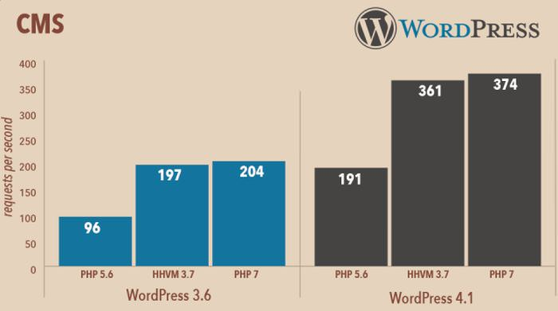
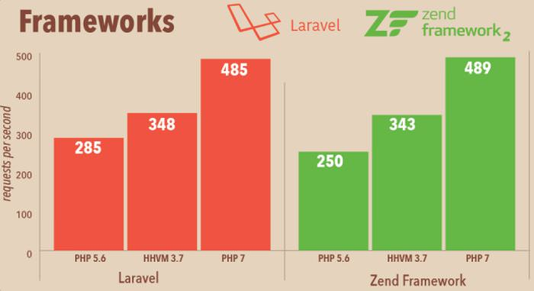
PHP has come long way
PHP current version is PHP 7
Lots of bug and security issues have been fixed
On the newest Zend Engine
Twice the speed

Slide 11
Tools
Day 1 - PHP Revision

Slide 12









Development Tools
Code Editor
Database Management
Web Server Stack
Dependency Manager
Sublime
Atom PHPStorm
XAMPP WAMPP
HeidiSQL
MySQL Workbench
Navicat
Composer
Notes:
Ini adalah tools digunakan untuk membangunkan aplikasi web. Terbahagi kepada 4 iaitu Code Editor, DB Management, Web Server Stack dan Dependency Manager.

Slide 13


Version Control
Register your account with Github at www.github.com.
At the end of this training, store your source code in github
Manage Source Code version Brilliantly

Slide 14
Basics
Day 1 - PHP Revision

Slide 15
Variables
variable1.php
variable2.php
<?php
$name = "Mohd Syafiq Azizi";
echo "Welcome to PHP World, ".$name;
?>
<?php
$item1 = 325.60;
$item2 = 545.40;
$gst = 0.06;
$service = 0.10;
$grandtotal = ($item1+$item2)+(($item1+$item2) * ($gst+$service));
echo $grandtotal;
?>

Slide 16
Array
array2.php
<?php
$course = array("SE" => "Software Engineering uses an engineering approach in the development, operation and maintenance of large scale software. A software engineer needs to be able to employ systematic technical and management methods in the creation of high quality software.",
"BioInformatic" => "Bioinformatics is an advanced and up-to-date field combining both science and technology which promises a very bright future whereby it involves the disciplines of computer science, mathematics and biology.",
"DS" => "Database System is specially designed together with industry inputs, to fulfill the much needed entry-level database technologist, who are responsible for the efficient and effective management of the lifeblood of an organization- its Data and Information. ");
echo $course["DS"];
?>
array1.php
<?php
$bakery = array("Kek", "Kuih", "Roti");
echo "I like " . $bakery[0] . ", " . $bakery[1] . " and " . $bakery[2] . ".";
?>
Notes:
In array1, the data is automatically assign to the number. But array2. The data is assigned by references.

Slide 17
Condition (if...else)
condition2.php
<?php
$name = "Mohd Syafiq";
$course = "Bachelor in Science Computer (Software Engineering)";
$cgpa = 4.0;
if($cgpa == 4.0){
$grade = "High Distinction";
}else if($cgpa >= 3.33 && $cgpa <= 3.99){
$grade = "Distinction";
}else if($cgpa >= 2.67 && $cgpa <= 3.32){
$grade = "Credit";
}else if($cgpa >= 2.00 && $cgpa <= 2.66){
$grade = "Pass";
}else if($cgpa <= 1.99){
$grade = "Failed";
}else{
$grade = null;
}
if($grade==null){
echo "Please Enter the correct CGPA";
}else{
echo "Welcome ".$name.". You have enroll ".$course.". Based on your CGPA (".$cgpa."), your grade is ". $grade;
}
?>
condition1.php
<?php
$username = "superadmin";
$usertype = "admin";
if($usertype == "user"){
echo "Welcome ".$username.". Your User Type is User";
}else{
echo "Welcome ".$username.". Your User Type is Admin";
}
?>

Slide 18
Condition (Switch)
condition4.php
<?php
$name = "Mohd Syafiq";
$course = "Bachelor in Science Computer (Software Engineering)";
$cgpa = 2.04;
switch ($cgpa) {
case $cgpa == 4.0:
$grade = "High Distinction";
break;
case $cgpa >= 3.33 && $cgpa <= 3.99:
$grade = "Distinction";
break;
case $cgpa >= 2.67 && $cgpa <= 3.32:
$grade = "Credit";
break;
case $cgpa >= 2.00 && $cgpa <= 2.66:
$grade = "Pass";
break;
case $cgpa <= 1.99:
$grade = "Failed";
break;
default:
$grade = null;
break;
}
switch ($grade) {
case $grade == null;
echo "Please Enter the correct CGPA";
break;
default:
echo "Welcome " . $name . ". You have enroll " . $course . ". Based on your CGPA (" . $cgpa . "), your grade is " . $grade;
break;
}
?>
condition3.php
<?php
$username = "superadmin";
$usertype = "admin";
switch ($usertype) {
case $usertype == "user":
echo "Welcome " . $username . ". Your User Type is User";
break;
default:
echo "Welcome " . $username . ". Your User Type is Admin";
break;
}
?>

Slide 19
Looping (for, foreach)
loop2.php
loop1.php
<strong>States: </strong>
<ul>
<?php
$states = array("Selangor", "Johor", "Negeri Sembilan", "Melaka", "Perak", "Perlis", "Kelantan", "Terengganu", "Pulau Pinang", "Pahang", "Sabah", "Sarawak", "Kuala Lumpur", "Labuan", "Putrajaya");
foreach ($states as $state) {
echo "<li>".$state . PHP_EOL."</li>";
}
?>
</ul>
<ul>
<?php
for ($ikea = 0; $ikea <= 14; $ikea++) {
echo "<li>".$ikea."</li>";
}
?>
</ul>
Notes:
The left is the for loop. The right is the foreach. Foreach only works if you use with an array

Slide 20
Looping (while, do...while)
loop4.php
loop3.php
<strong>States: </strong>
<ul>
<?php
$states = array("Selangor", "Johor", "Negeri Sembilan", "Melaka", "Perak", "Perlis", "Kelantan", "Terengganu", "Pulau Pinang", "Pahang", "Sabah", "Sarawak", "Kuala Lumpur", "Labuan", "Putrajaya");
$num = 0;
do{
echo "<li>".$states[$num] . PHP_EOL."</li>";
$num++;
}while($num <= 6);
?>
</ul>
<ul>
<?php
$ikea = 0;
while ($ikea <= 14) {
echo "<li>".$ikea."</li>";
$ikea++;
}
?>
</ul>
Notes:
The left is the for loop. The right is the foreach. Foreach only works if you use with an array

Slide 21
Object
object.php
<?php
class Training {
function Training() {
$this->framework = "Yii2 Framework";
}
}
// create an object
$train = new Training();
// show object properties
echo $train->framework;
?>

Slide 22
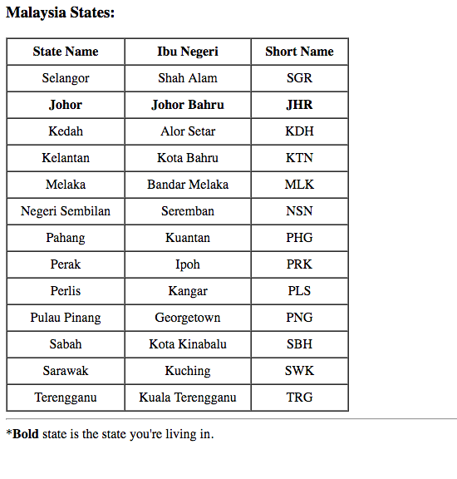
Exercise
Create as follow using HTML, array, object class, loop and condition

